Slide 1
Adversarially Reweighted Learning
Presented By:

Slide 2
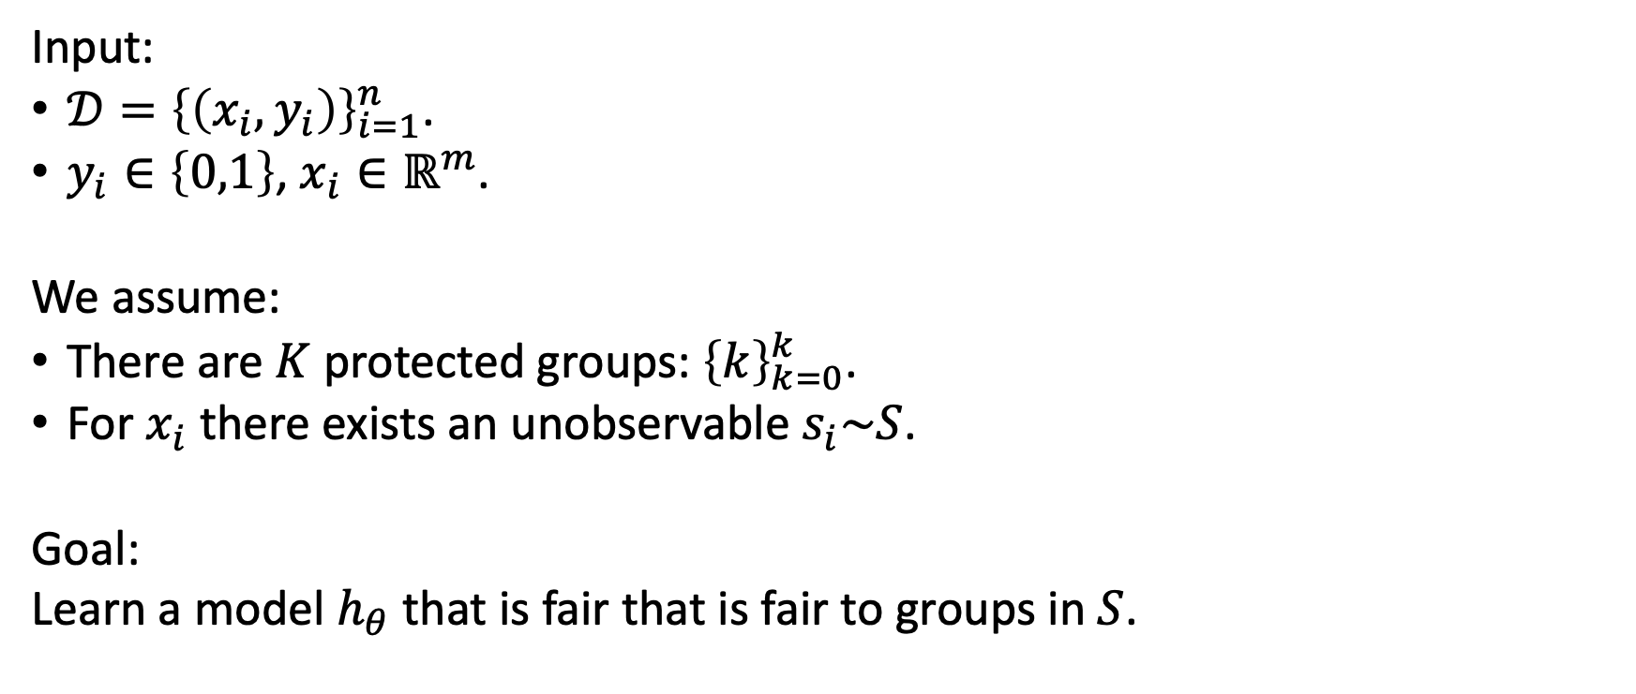
Problem formulation
Input:
$𝒟={\left\{\left(x_{i},y_{i}\right)\right\}}_{i=1}^{n}$.
$y_{i}∈\left\{0,1\right\}$, $x_{i}∈ℝ^{m}$.
We assume:
There are $K$ protected groups: ${\left\{k\right\}}_{k=0}^{k}$.
For $x_{i}$there exists an unobservable $s_{i}\sim S$.
Goal:
Learn a model $h_{θ}$ that is fair that is fair to groups in $S$.

Slide 3
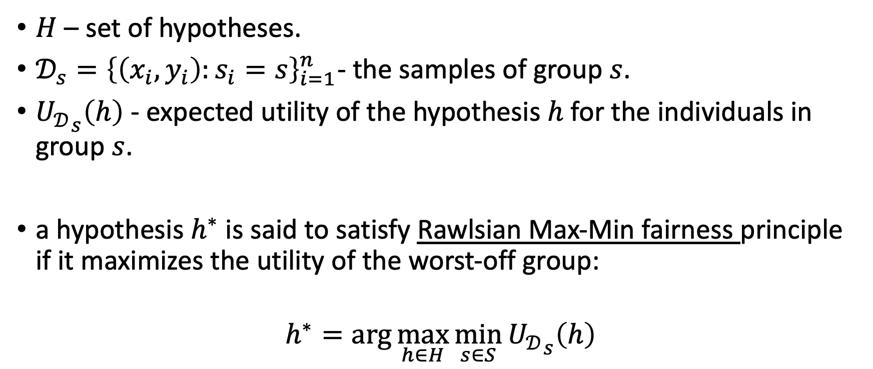
Fairness definition (Rawlsian Max-Min)
$H$ – set of hypotheses.
$𝒟_{s}={\left\{\left(x_{i},y_{i}\right):s_{i}=s\right\}}_{i=1}^{n}$- the samples of group $s$.
${U_{𝒟}}_{s}\left(h\right)$ - expected utility of the hypothesis $h$ for the individuals in group $s$.
a hypothesis $h^{∗}$ is said to satisfy Rawlsian Max-Min fairness principle if it maximizes the utility of the worst-off group:
$$h^{∗}=\arg{\max_{h∈H}{\min_{s∈S}{{U_{𝒟}}_{s}\left(h\right)}}}$$

Slide 4
Adversarial Reweighted Learning
In order to achieve fairness the authors choose to use Adversarial Reweighted Learning (ARL).
Using a dual headed network, they defined the following MinMax problem:
$$J\left(Θ,λ\right)≔\min_{Θ}{\max_{λ}{Σ_{i=0}^{n}}λ_{i}ℓ\left(𝒽\left(𝓍_{i}\right),𝓎_{i}\right)}$$
The base model tries to minimize the total loss w.r.t. the weights (lambda values), while the adversarial model tries to find assignments to the weights in order to maximize the weighted loss.

Slide 5
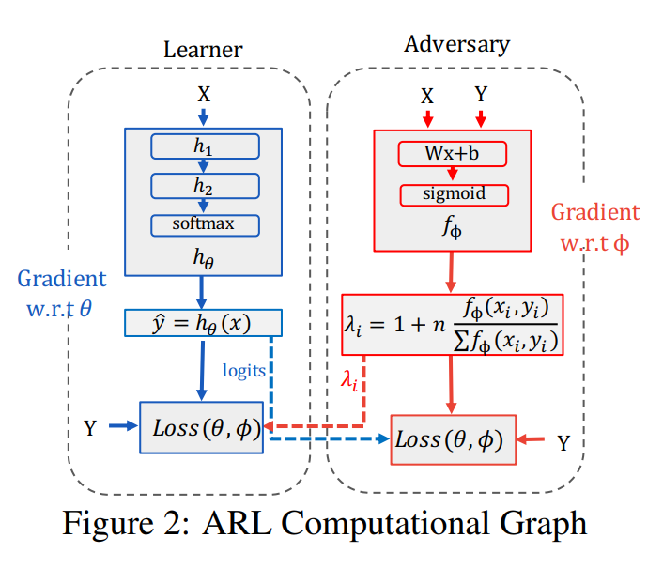
Adversarial Reweighted Learning
In practice, the adversary head learns a $f_{Φ}$ function, and we compute $λ$ values as a normalization over the $f_{Φ}$ output (in order to avoid zero weights for all and the exploding gradients problem).

Slide 6
Adversarial Reweighted Learning
The main idea behind this design is to achieve equal accuracy across all protected groups, since if the model preform worse on a specific group, it’s lambda values will increase, which will cause the model to better classify it’s members.
In an ideal scenario, the learner is fair of all protected groups, and thus will suggest equal lambda values.

Slide 7
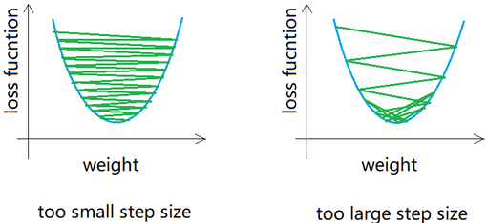
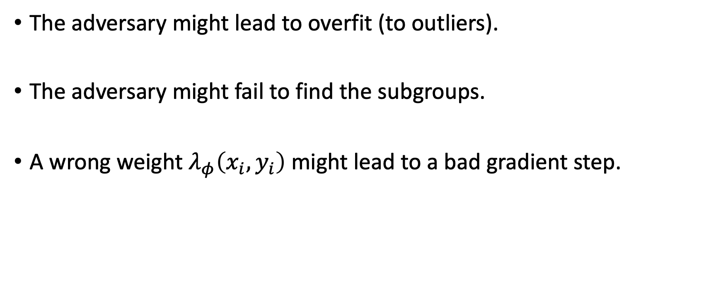
ARL limitations
The adversary might lead to overfit (to outliers).
The adversary might fail to find the subgroups.
A wrong weight $λ_{φ}\left(x_{i},y_{i}\right)$ might lead to a bad gradient step.

Slide 8
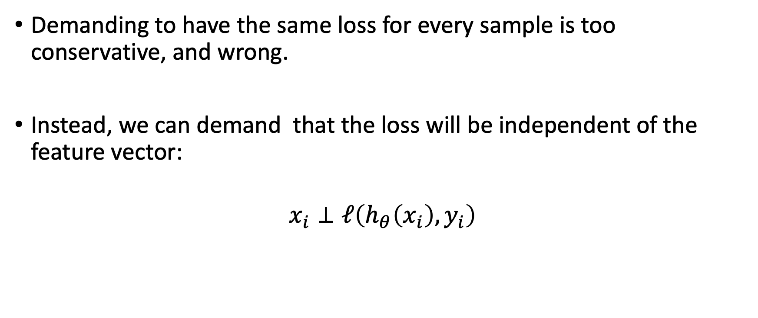
Improving methods motivations
Demanding to have the same loss for every sample is too conservative, and wrong.
Instead, we can demand that the loss will be independent of the feature vector:
$$x_{i}⊥ℓ\left(h_{θ}\left(x_{i}\right),y_{i}\right)$$

Slide 9
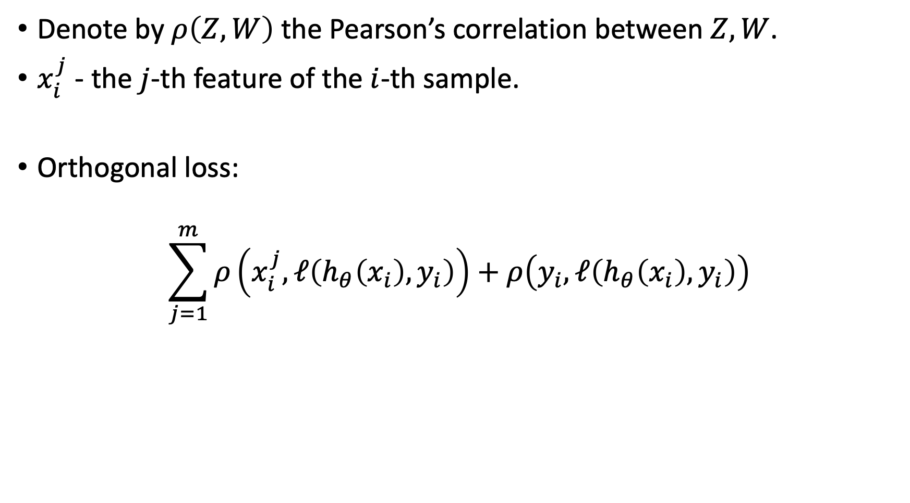
Adversarial Orthogonal Learning (AOL)
Denote by $ρ\left(Z,W\right)$ the Pearson’s correlation between $Z,W$.
$x_{i}^{j}$ - the $j$-th feature of the $i$-th sample.
Orthogonal loss:
$$\sum_{j=1}^{m}{ρ\left(x_{i}^{j},ℓ\left(h_{θ}\left(x_{i}\right),y_{i}\right)\right)}+ρ\left(y_{i},ℓ\left(h_{θ}\left(x_{i}\right),y_{i}\right)\right)$$

Slide 10
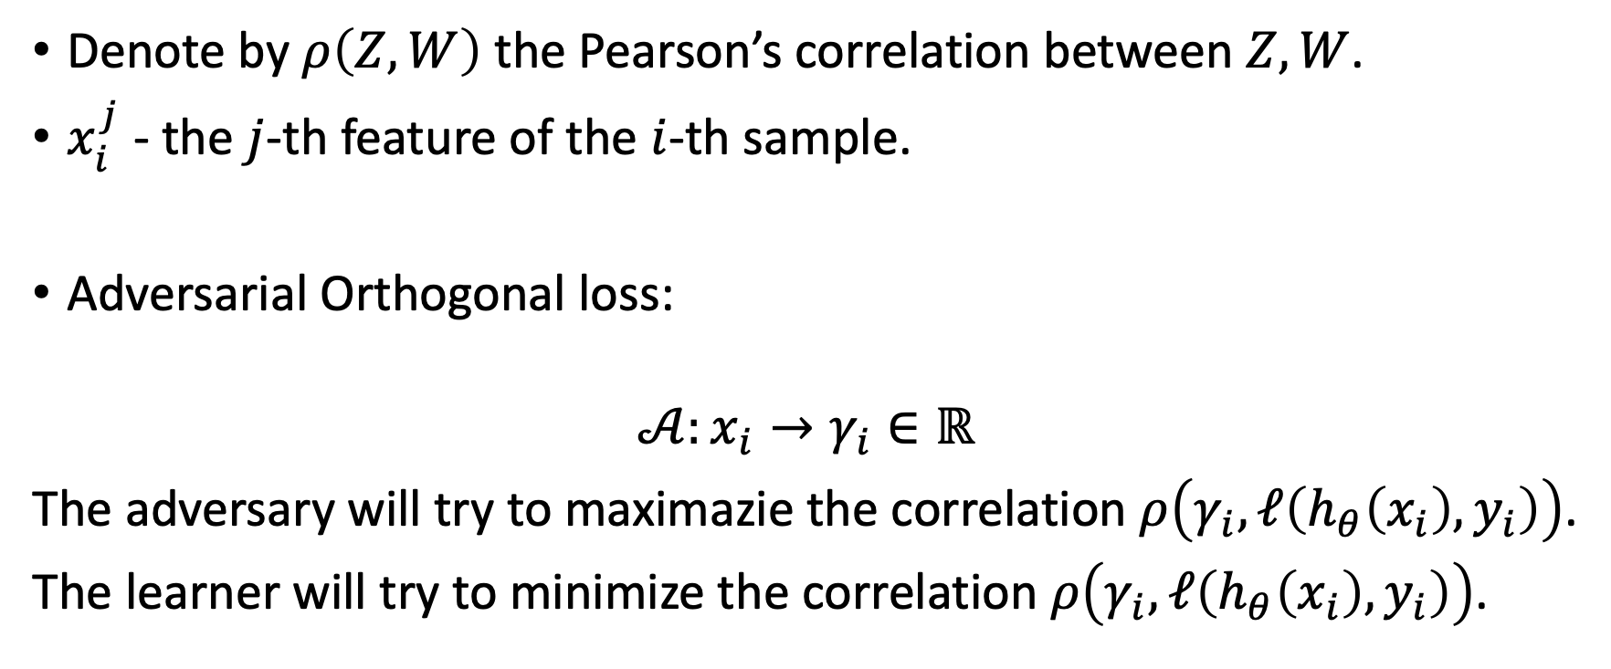
Adversarial Orthogonal Learning (AOL)
Denote by $ρ\left(Z,W\right)$ the Pearson’s correlation between $Z,W$.
$x_{i}^{j}$ - the $j$-th feature of the $i$-th sample.
Adversarial Orthogonal loss:
$$𝒜:x_{i}→γ_{i}∈ℝ$$
The adversary will try to maximazie the correlation $ρ\left(γ_{i},ℓ\left(h_{θ}\left(x_{i}\right),y_{i}\right)\right)$.
The learner will try to minimize the correlation $ρ\left(γ_{i},ℓ\left(h_{θ}\left(x_{i}\right),y_{i}\right)\right)$.

Slide 11
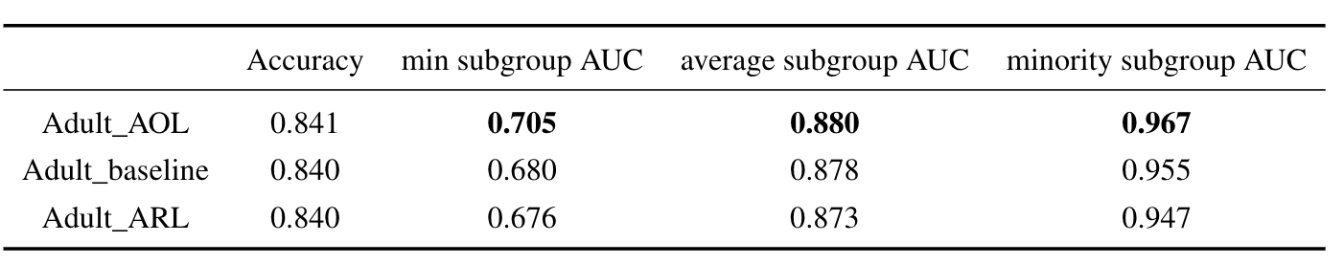
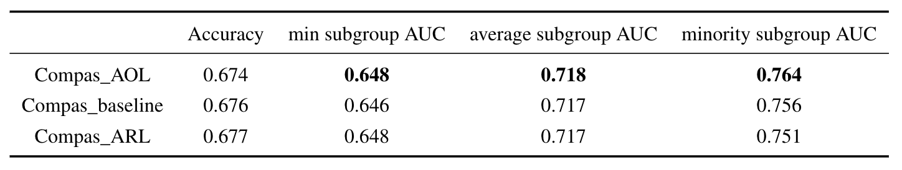
Results
Results averaged over 20 seeds.

